Slide 1
Digital Sales Aid Technical Knowledge Transfer for DuPont iOS Application

Slide 2
Contents
Architecture
Pre-Installation Preparations
DuPont Salesforce DSA Package Installation
DuPont DSA iOS App Installation
Adding a New User
Adding a New DSA Administrator User

Slide 3
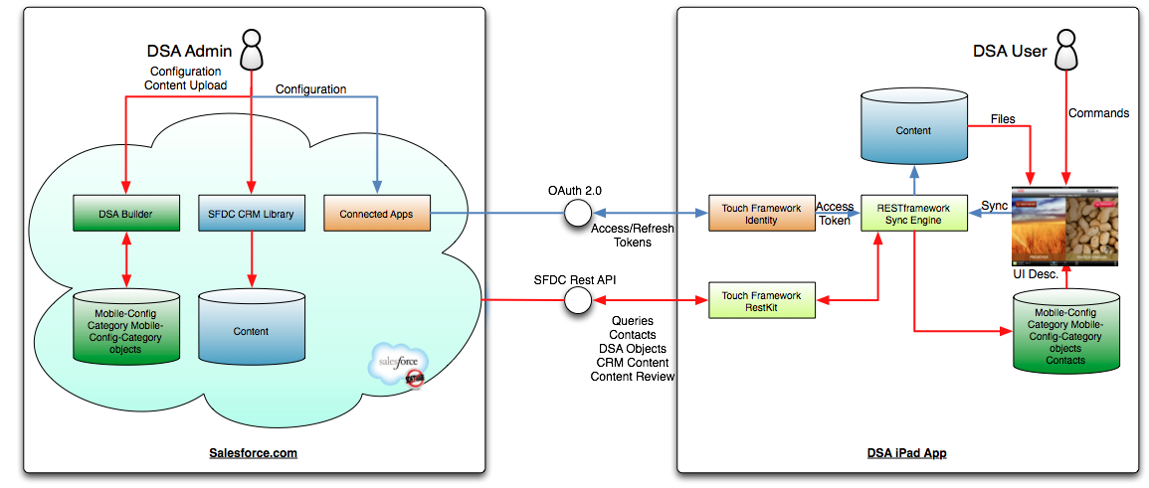
DSA System Architecture

Slide 4
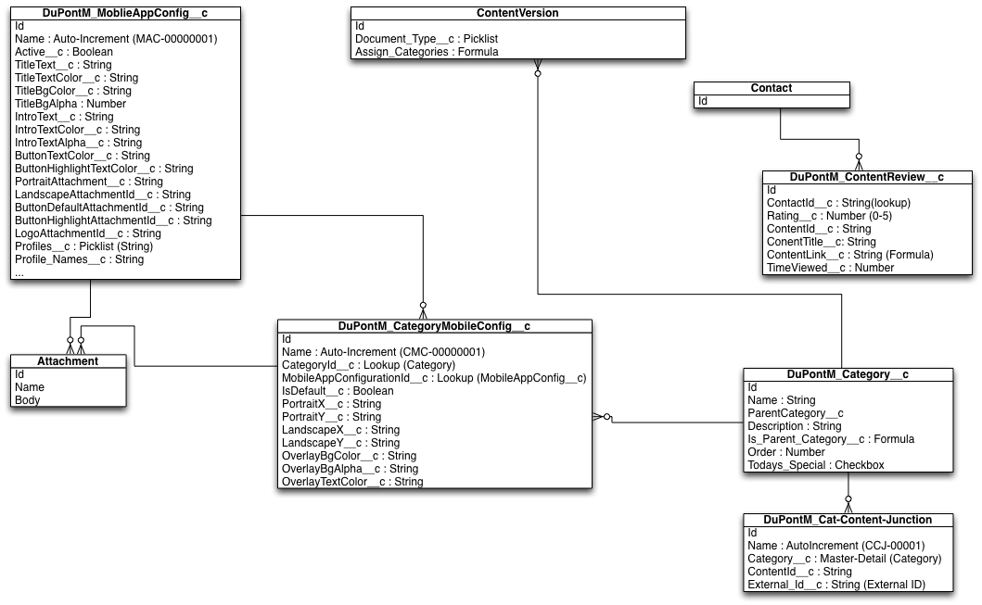
DSA Entity Relationship Diagram

Slide 5
DSA Authentication/Authorization
The DSA App uses the Touch Identity Framework.
OAuth2.0 UI Patterns are used to Authenticate the user and obtain an Access Token with ID and API Scope.
MM_LoginViewController is used to implement the OAuth UI
The Touch Identity Framework handles the Access/Refresh token protocols for the DSA.
The Access Token is used for the REST calls

Slide 6
Design Patterns of the iOS App
The DSA App is based on the Model-View-Controller Design Pattern for the definition of its user interface.
Model:
CoreData database which contains the Salesforce Defined GUI Definition Objects and URI to the Downloaded Content
SFDC CRM Content
View:
Constructed from iOS View Classes: UITableView, UIScrollView
Controllers:
MM_BaseViewController: SyncControl, Login
MM_FlexibleVisualBrowser: Category Browsing
DSA_MediaDisplayViewController: Display Content Files

Slide 7
Design Patterns of the iOS App - 2
Synchronization (DSA REST FRAMEWORK).
Uses Touch Framework to access SFDC on behalf of the user using REST calls.
Initial Download of the Model and the Content
Populate the CoreData with Mobile_Config, Category_Mobile_Configuration, Category, Contact, etc. Objects
sync_objects.plist defines the objects to be synchronized and the synchronization strategy.
Populate with Content local URI
Synchronization
Compare existing SFDC ID of the CoreData objects with those in SFDC to determine new, deleted and modified objects
Download Model
Download Content
DSA_MediaDisplayViewController: Display Content Files

Slide 8
Reference

Slide 9
Documents
01.02.12_DuPont DSA Design Review –Technical Details of the DSA Implementation for DuPont
DSA V3 Implementation Guide – General DSA Guide
Touch Framework – http://media.developerforce.com/pdfs/salesforce_touch_platform.pdf

